Slide 1

Weather Forecasting using Dynamic Mode Decomposition
By: Michael Campiglia and Anton Paljusevic
9th December 2019
Department of Mathematics
Manhattan College
Riverdale, NY
MATG 511

Slide 2

Introduction
Predicting or forecasting weather is done using various methods, most rely on either finding historical patterns similar to present day conditions or using numerical analysis with established weather equations.
Historical pattern recognition may not provide accurate results and using the more precise numerical analysis method requires complex equations and large computers for calculations.
A possible alternative method would be using Principle Component Analysis (PCA) and Dynamic Mode Decomposition (DMD) as a forecasting tool to predict future days based on daily historical recorded data.
The goal of our project is to take daily historic weather recordings for a given location (New York), reduce the amount of data using PCA, and then run the reduced time series data through DMD to produce a function of time that outputs and predicts weather conditions.

Slide 3
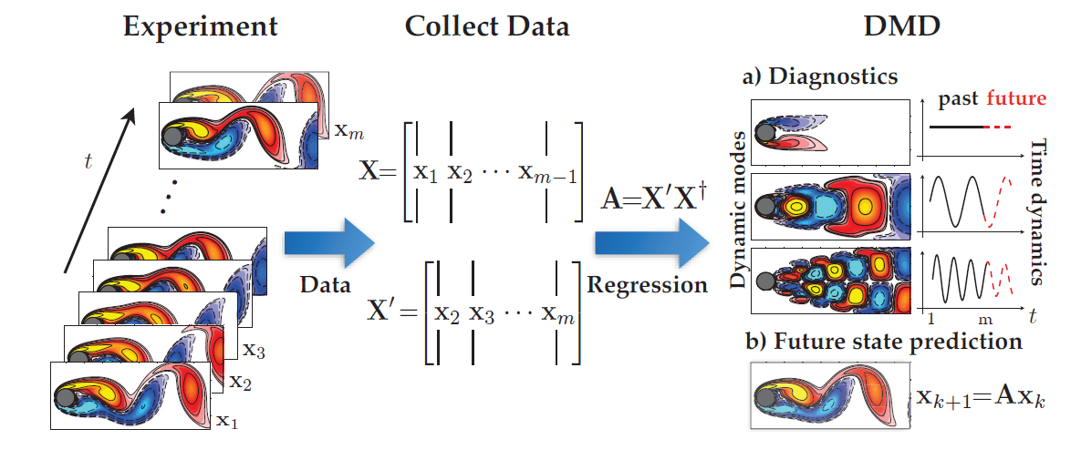
Background – Dynamic Mode Decomposition
Dynamic Mode Decomposition, referred to as DMD, is a relatively new dimensionality reduction method that captures the spatio-temporal dynamics of a dynamical system and computes a set of modes for a time series of data, allowing us to predict how the system will change over time using the temporal evolution of the data.

Slide 4
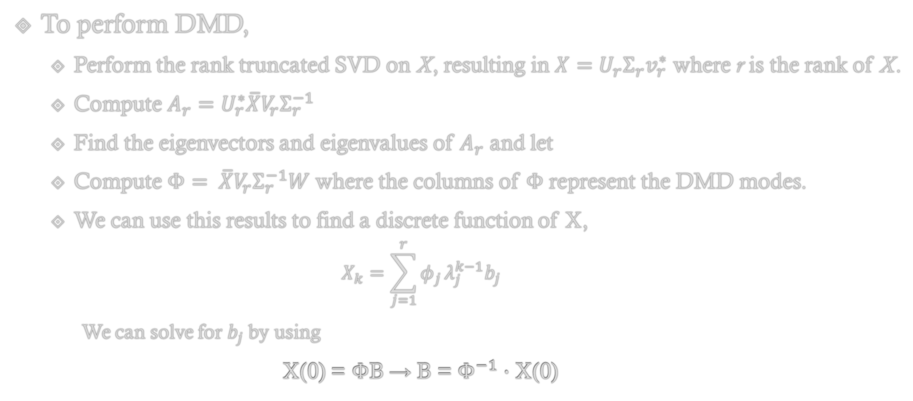
Methods – Dynamic Mode Decomposition
To perform DMD,
Perform the rank truncated SVD on X, resulting in $X=U_{r}Σ_{r}v_{r}^{∗}$ where r is the rank of X.
Compute $A_{r}=U_{r}^{∗}\overline{X}V_{r}Σ_{r}^{−1}$
Find the eigenvectors and eigenvalues of $A_{r}$ and let
Compute $Φ= \overline{X}V_{r}Σ_{r}^{−1}W$ where the columns of $Φ$ represent the DMD modes.
We can use this results to find a discrete function of X,
$$X_{k}=\sum_{j=1}^{r}{φ_{j}}λ_{j}^{k−1}b_{j}$$
We can solve for $b_{j}$ by using
X(0) = ΦB → B = $Φ^{−1}$ · X(0)

Slide 5
Implementation of Tools
DMD is our tool for forecasting the weather data. With the DMD function that we create in Python, we will pass through the weather data and it will return a matrix function of time.
We will test this function to make sure that the output for a given day is similar to the original data, and then use the function to forecast days that are outside of the known dataset.
Various datasets and adjustments to the datasets will be tested using the function.

Slide 6
Dataset Description
The first dataset that we worked with consisted of historical weather data obtained from NOAA.gov, a federal agency that is responsible for research and tracking of Earth systems.
Each column in the dataset corresponds to a piece of recorded observation data and each row in the file corresponds to the date and time of the set of observation. In order to perform DMD however, we want each consecutive day to represent the columns, so we transposed the matrix for this to be the case.
The types of data recorded include wind and gust speed, wind direction, temperature and dewpoint readings, humidity readings, various pressure readings by location, precipitation readings, and observed weather conditions.
The data will need to be prepared prior to computations by ensuring there are no repeating date rows and that all the null and categorical recordings are converted to numerical values.

Slide 7
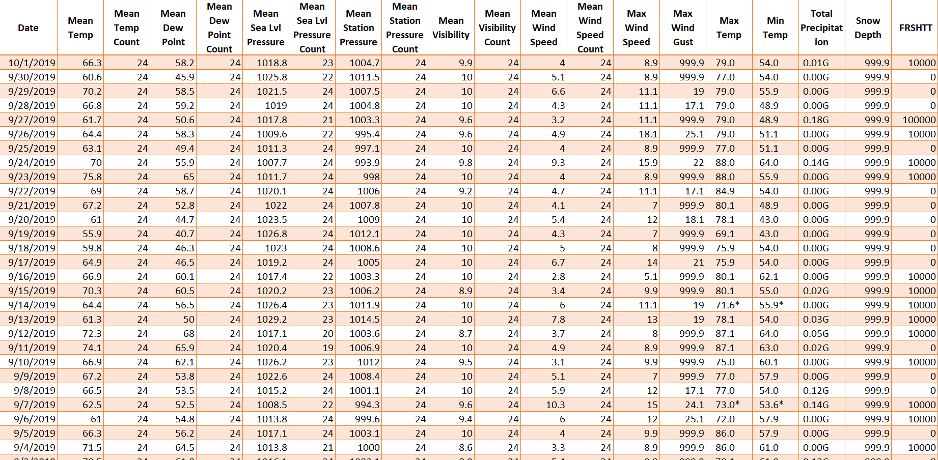
Raw Dataset from NOAA.gov
PUT PICTURE OR VISUALIZATION OF DATASET HERE

Slide 8
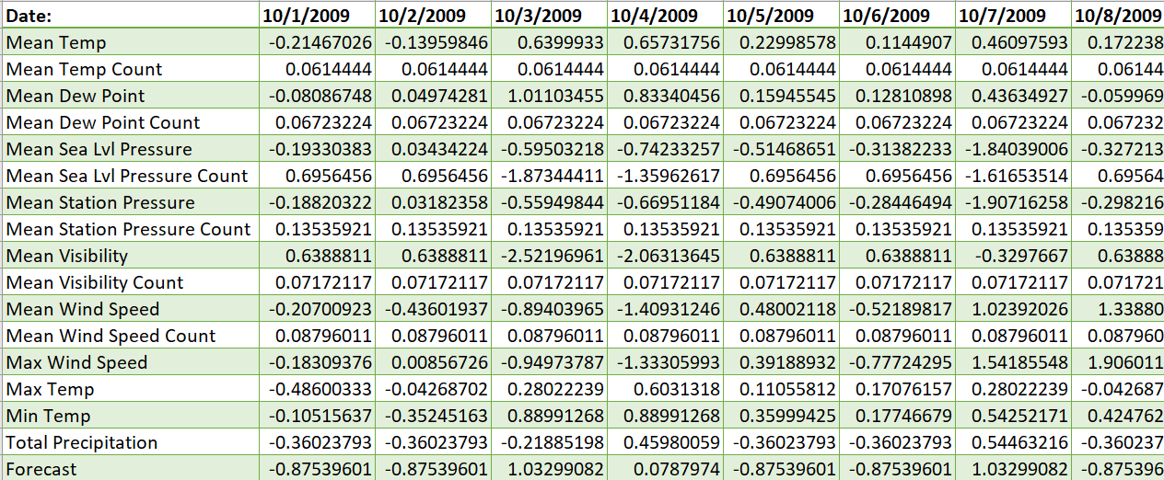
Cleaned, Normalized, and Transposed Data

Slide 9
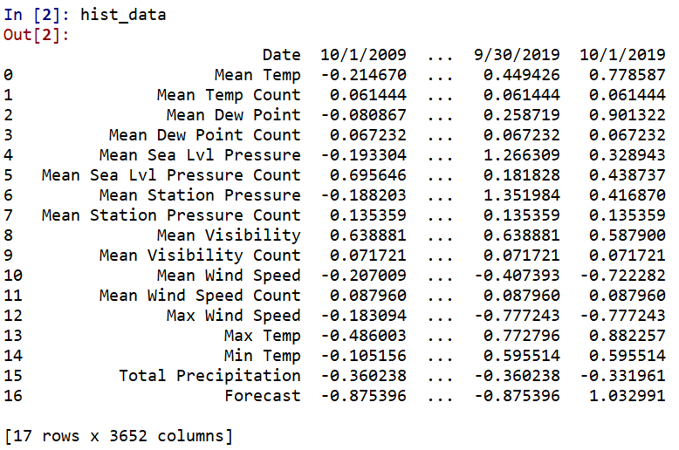
Imported Data Frame on Python

Slide 10
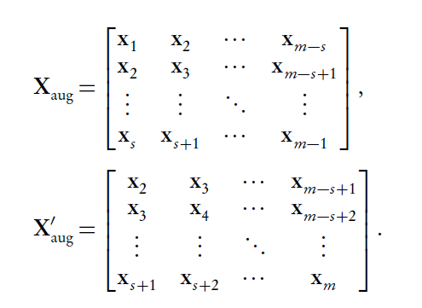
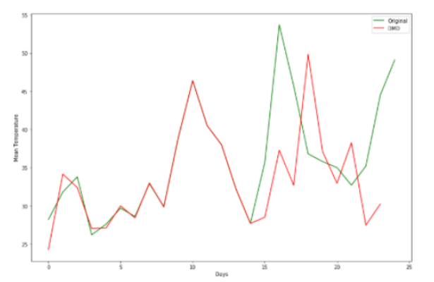
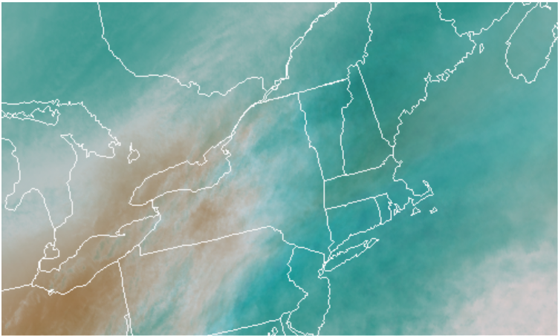
Results
Dynamic Mode Decomposition function tests:
Perform DMD on the full dataset
Alter the dataset through augmentation prior to DMD
Split the dataset into various smaller datasets prior to DMD
Convert satellite imagery to a matrix then perform DMD

Slide 11
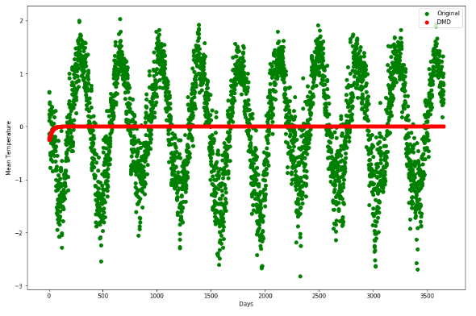
Results - Initial Dataset Test

Slide 12
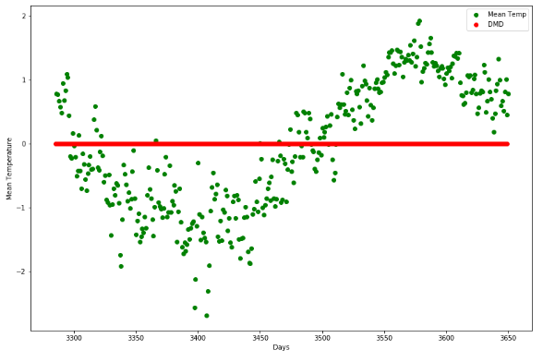
Results - Initial Dataset Test

Slide 13
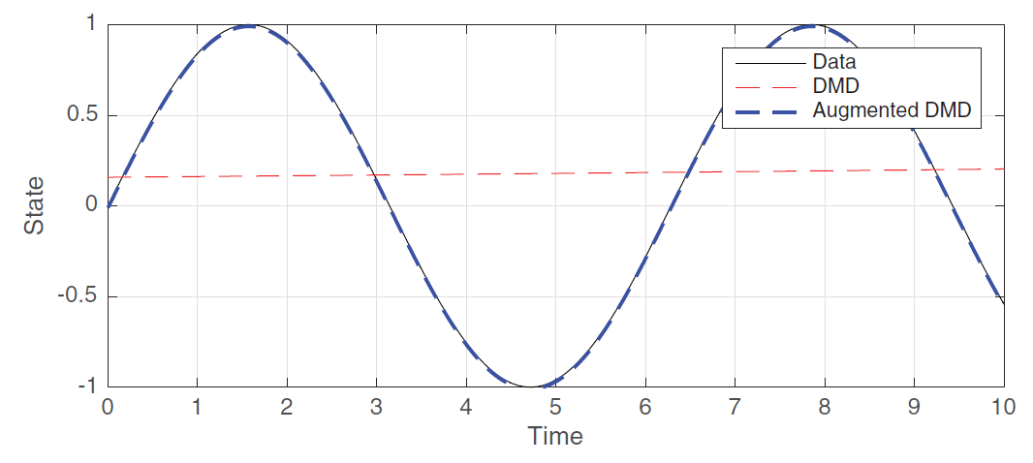
Results - Augmented Dataset Test
Augmentation works by duplicating the data to force a higher rank matrix using the general form above.
Proven in DMD textbook to work on sin wave functions.

Slide 14
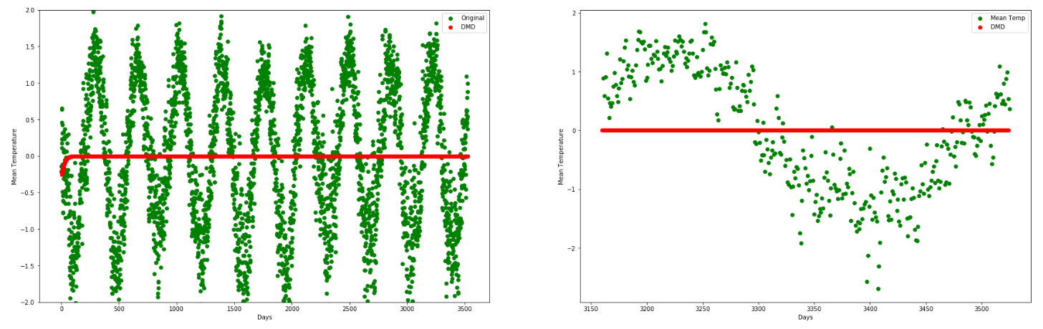
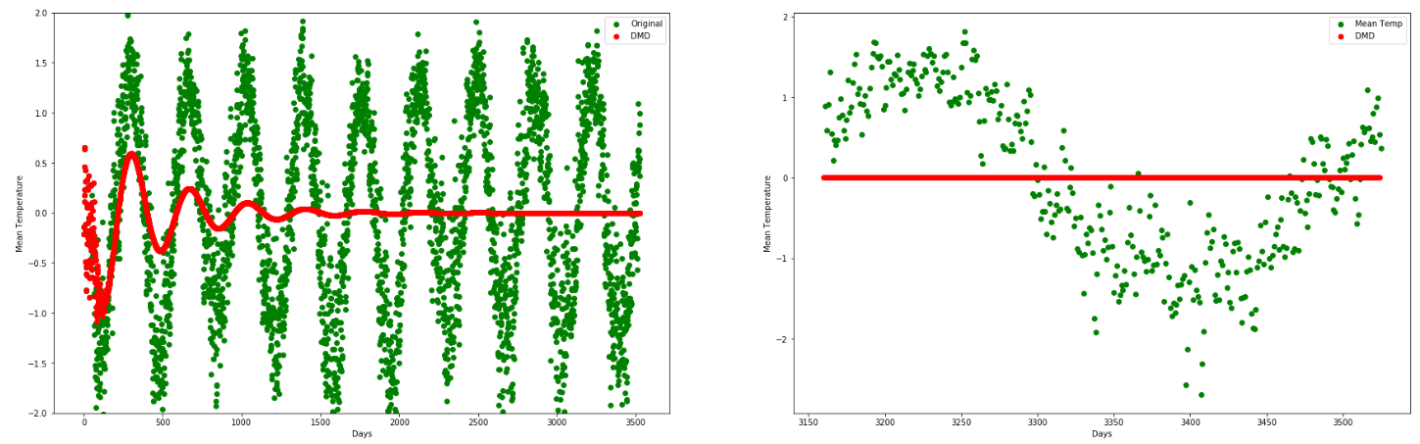
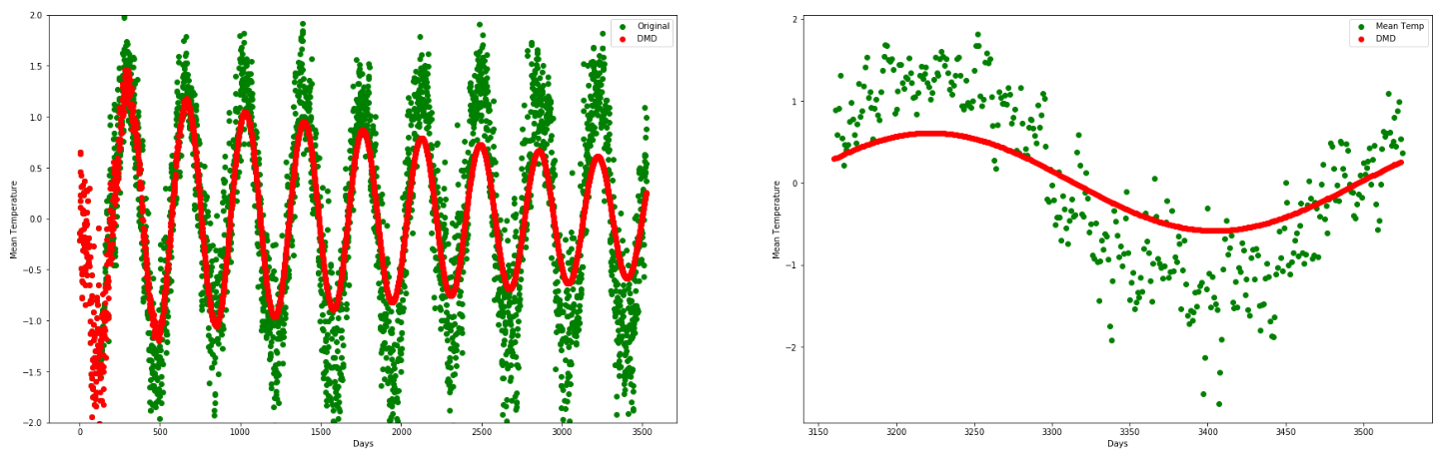
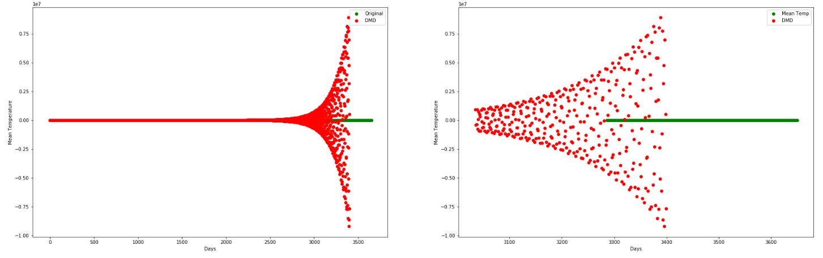
Results - Augmented Dataset Test
No Augmentation
Augmented 50x
Augmented 125x
Augmented 250x

Slide 15
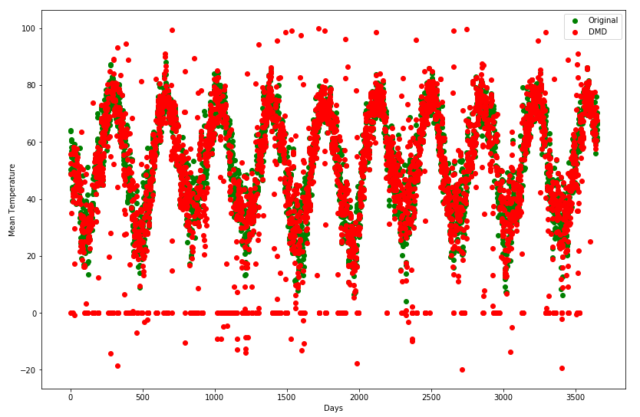
Results - Partitioned Dataset Test

Slide 16
Results - Partitioned Dataset Test

Slide 17
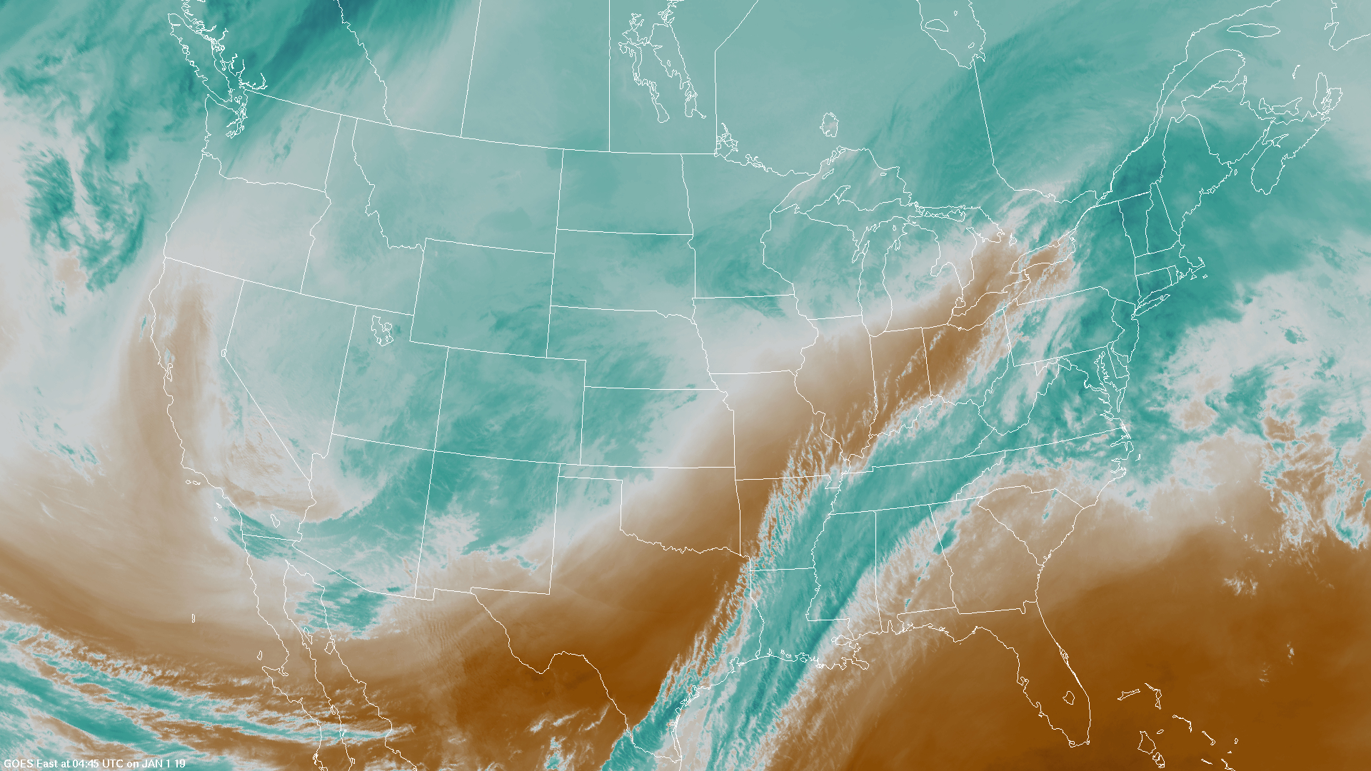
Results – Imagery Dataset Test

Slide 18
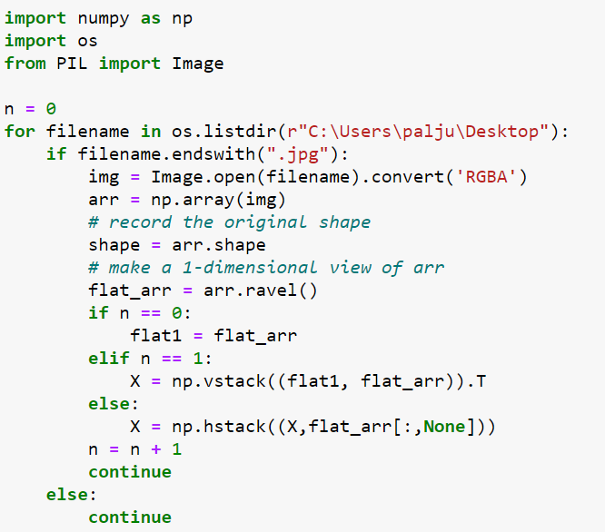
Results – Imagery Dataset Test
Python function cycles through saved images, converts to RGB matrix, and appends to an X matrix as one column per picture

Slide 19
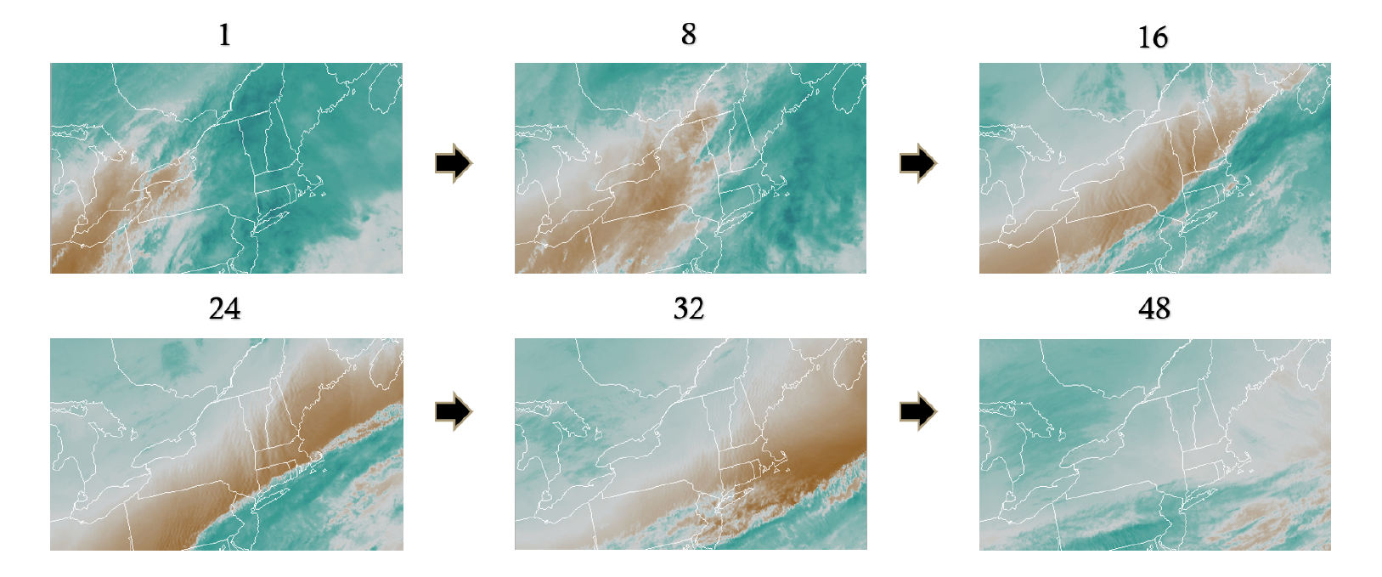
Results – Imagery Dataset Test
The following are the original cropped images (30 min intervals, 48 images, 1 day)used to test the DMD algorithm:

Slide 20
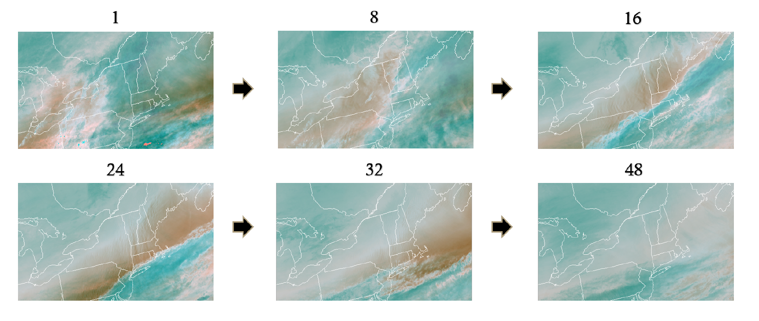
Results – Imagery Dataset Test
The following are the reconstructed images returned from the DMD algorithm:

Slide 21
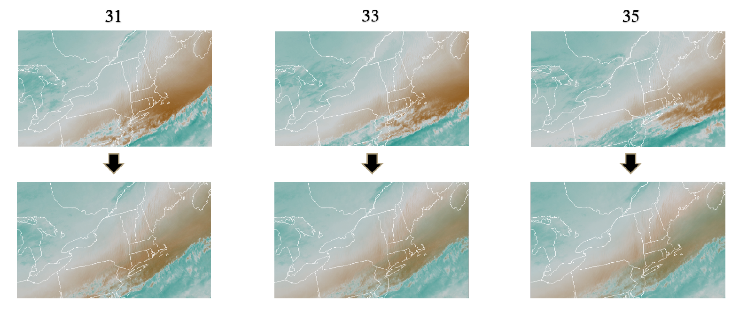
Results – Imagery Dataset Test
The following are predictions when using part of the dataset (30 of 48 images) for training and the rest for testing:

Slide 22
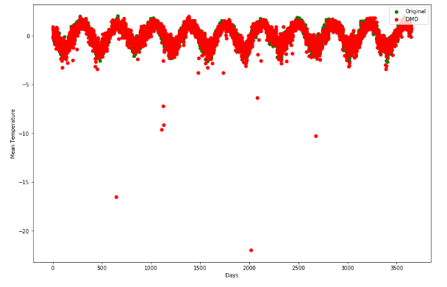
Other Notable Results - Using ‘A’ Matrix

Slide 23
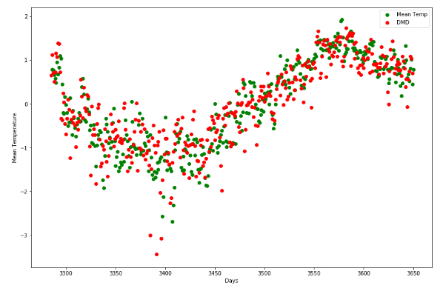
Other Notable Results - Using ‘A’ Matrix

Slide 24

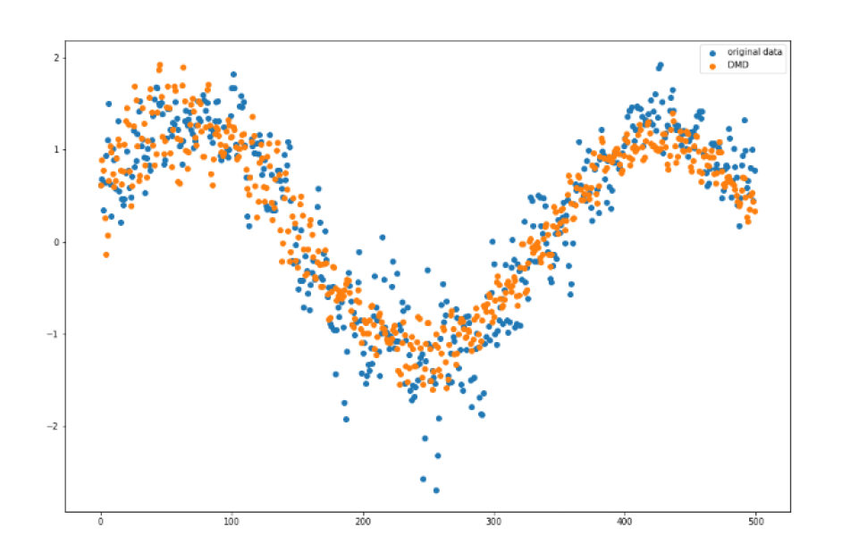
Moving Forward
Test other variations of DMD:
Higher Order DMD
Optimizing augmentation
Testing other datasets:
Different satellite imagery (cloud coverage, wind, temperature gradient)
Combining various weather station readings to allow for larger partitioned datasets.
Incorporate and test PCA on datasets.
Higher Order DMD

Slide 25
References
[1]Kutz, J. Nathan, et al. Dynamic mode decomposition: data-driven modeling of complex systems. Society for Industrial and Applied Mathematics, 2016.
[2] Neethu Mohan, K.P. Soman, S. Sachin Kumar, A data-driven strategy for short-term electric load forecasting using dynamic mode decomposition model, Applied Energy, Volume 232, 2018, Pages 229-244, ISSN 0306-2619, https://doi.org/10.1016/j.apenergy.2018.09.190.
[3] Hua, Jia-Chen Roy, Sukesh McCauley, Joseph Gunaratne, Gemunu. (2015). Using dynamic mode decomposition to extract cyclic behavior in the stock market. Physica A: Statistical Mechanics and its Applications. 448. 172â180. 10.1016/j.physa.2015.12.059.
[4] Santosh Tirunagari, Samaneh Kouchaki, Norman Poh, Miroslaw Bober, David Windridge. Dynamic Mode Decomposition for Univariate Time Series: Analysing Trends and Forecasting. 2017. â¨hal-01463744âŠ
[5] Bi, Chongke, et al. "Dynamic mode decomposition based video shot detection." IEEE Access 6 (2018): 21397-21407.
[6] C.W. Rowley, I Mezic, S. Bagheri, P. Schlatter, and D.S. Henningson, "Spectral analysis of nonlinear flows." Journal of Fluid Mechanics 641 (2009): 85-113
[7] Hirsh, Seth M., et al. "Centering Data Improves the Dynamic Mode Decomposition." arXiv preprint arXiv:1906.05973 (2019).
[8] Santosh Tirunagari, Samaneh Kouchaki, Norman Poh, Miroslaw Bober, David Windridge. Dynamic Mode Decomposition for Univariate Time Series: Analysing Trends and Forecasting. 2017. â¨hal01463744âŠ
[9] Kutz, J. Nathan et al. âOn Dynamic Mode Decomposition: Theory and Applications.â Journal of Computational Dynamics 1.2 (2014): 391â421. Crossref. Web.
[10] https://www.britannica.com/science/weather-forecasting/Progress-during-the-early-20th-century

